Slide 1
Bank Marketing Campaign Analysis Using Deep Learning Models Diverse Model Comparisons
5500 Final Project
Group 3

Slide 2
Project Overview
Goal: Predict whether a client will subscribe to a term deposit
Significance: Help financial institutions optimize marketing strategies
Challenge: Highly imbalanced dataset (89% no / 11% yes)
Approach: Compare multiple deep learning architectures

Slide 3
Dataset Description
Source: Portuguese banking institution marketing campaigns
Size: 29,271 training records, 11,917 test records
Features: 15 attributes including:
Demographic data (age, job, education)
Financial indicators (housing loan, personal loan)
Campaign details (contact type, month, duration)
Target: Binary outcome - subscription (yes/no)

Slide 4
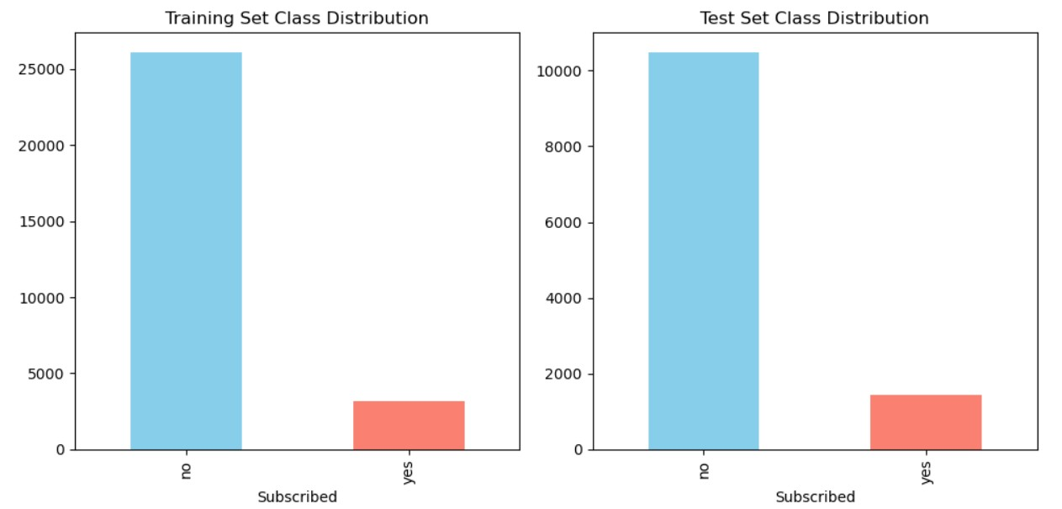
Class Imbalance
Training set: 26,075 no / 3,196 yes (89% / 11%)
Test set: 10,473 no / 1,444 yes (88% / 12%)
Significant imbalance requiring special handling

Slide 5
Data Preprocessing
Missing Values: Replaced 'unknown' with mode values
Special Values: Converted pdays=999 to -1
Encoding: Label encoding for categorical features
Scaling: Standardization of numerical features
Class Imbalance: Applied class weights during training
Reshaping: Additional dimension for CNN and RNN models

Slide 6
Model Architectures
Neural Network Approaches:
MLP (Multilayer Perceptron)
Simple feedforward architecture with dropout
CNN (Convolutional Neural Network)
Features treated as sequence with convolutional operations
LSTM (Long Short-Term Memory)
Recurrent network with memory cells
RNN (Simple Recurrent Neural Network)
Basic recurrent architecture
Linear

Slide 7
Training Configuration
Loss Function: Binary cross-entropy
Optimizer: Adam (learning rate = 0.001)
Early Stopping: Patience of 5 epochs
Class Weights: Balanced weighting
Batch Size: 64
Validation Split: 20%
Maximum Epochs: 50

Slide 8
Model Performance
Model | Accuracy | Precision | Recall | F1 Score
MLP | 0.1385 | 0.1233 | 1.0000 | 0.2196
CNN | 0.1384 | 0.1233 | 1.0000 | 0.2195
LSTM | 0.1355 | 0.1229 | 1.0000 | 0.2190
RNN | 0.1354 | 0.1229 | 1.0000 | 0.2189
Linear | 0.1386 | 0.1233 | 1.0000 | 0.2196

Slide 9
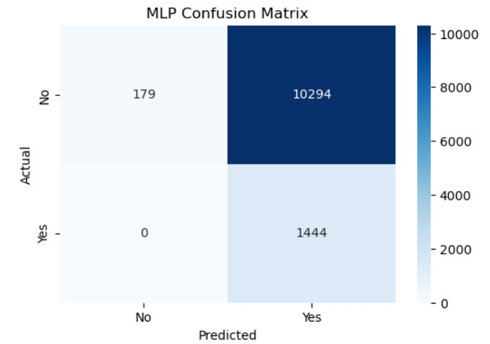
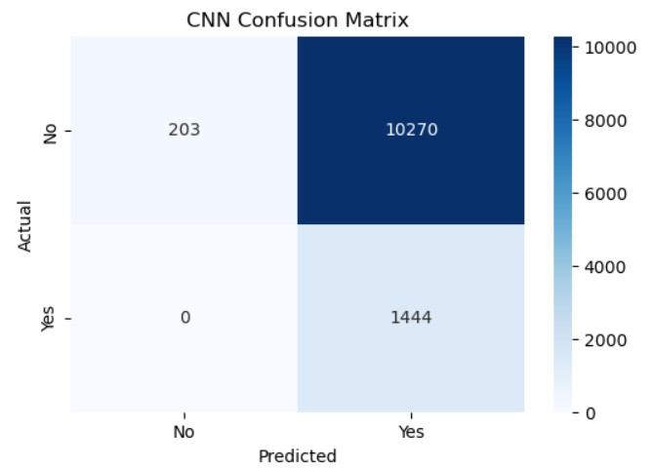

Confusion Matrices
All models showed similar behavior:
Perfect recall (1.0)
Very low precision (~0.12)
Predicted all instances as positive

Slide 10
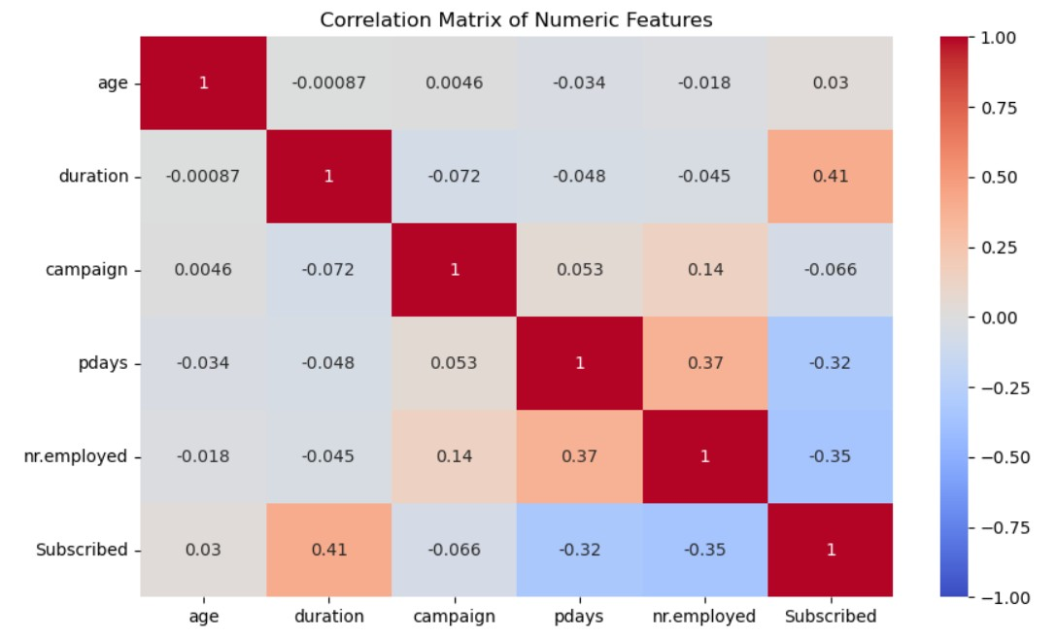
Feature Importance
Key Predictors:
Call duration (strongest correlation)
Previous campaign outcome
Month of contact
Contact method

Slide 11
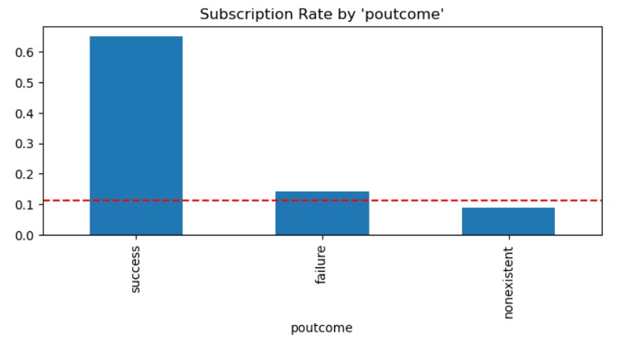
Subscription Rate by Previous Outcome
Customers with successful previous interactions showed ~60% subscription rate
Overall average subscription rate: ~11%
Strong indicator for targeted marketing

Slide 12
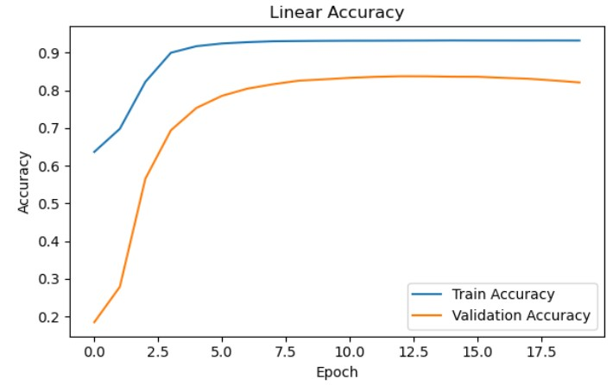
Training Behaviour
Rapid initial learning (1-2 epochs)
Early overfitting in MLP and CNN (2-3 epochs)
LSTM showed more resistance to overfitting
Linear model had most stable learning curve

Slide 13
Key Findings
Similar Performance: All models performed nearly identically
Extreme Prediction Behavior: All models predicted every instance as positive
Class Imbalance Impact: Overcompensation in handling class weights
Feature Insights: Duration, previous outcome, and contact timing most important
Model Complexity: Simpler models performed as well as complex ones

Slide 14
Marketing Recommendations
Targeted Retargeting: Prioritize customers with previous successful interactions
Seasonal Planning: Focus campaigns during high-conversion months
Contact Method: Prefer cellular contacts over landline
Economic Context: Increase efforts during lower employment periods
Conversation Quality: Focus on meaningful customer interactions

Slide 15
Future Improvements
Alternative Sampling: SMOTE, ADASYN, or under-sampling
Feature Engineering: Develop new features based on key predictors
Threshold Adjustment: Optimize precision-recall tradeoff
Ensemble Methods: Combine multiple models
Hyperparameter Optimization: Focus on learning rate and regularization

Slide 16
Conclusion
Model Selection: Simpler models performed best (Linear model highest F1 score)
Class Imbalance: Remains a significant challenge requiring better approaches
Prediction Behavior: Current approach needs refinement to avoid all-positive predictions
Business Value: Analysis identified key predictors for marketing success
Next Steps: Implement recommendations and improved modeling techniques

